Slide 1
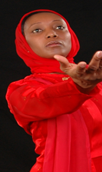
“The Dancer - Pioneer who keeps advancing forward with no halting in mind. Trotting every step to her destination”

Slide 2
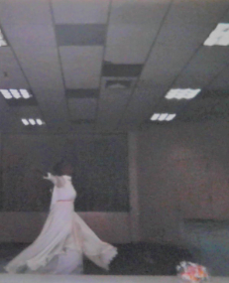
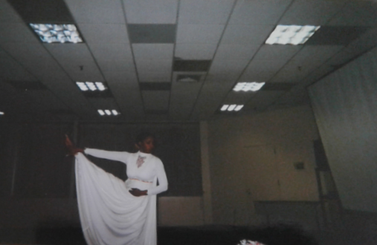
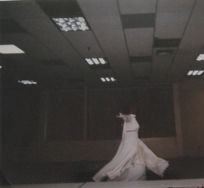
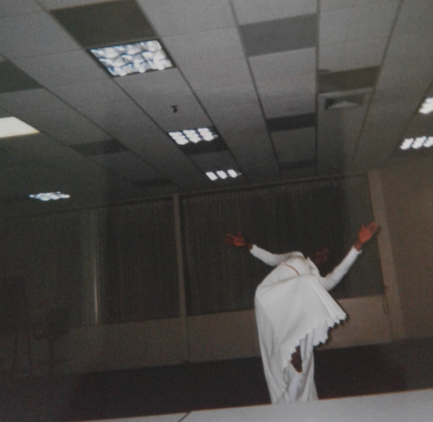
Vilma Angela Simon Bond, was born in the Island of Trinidad and Tobago. At age sixteen Vilma enrolled in the Astor Johnson Repertory Dance Company and Workshop, there she studied Modern Dance for two-years under the Martha Graham Style.

Slide 3
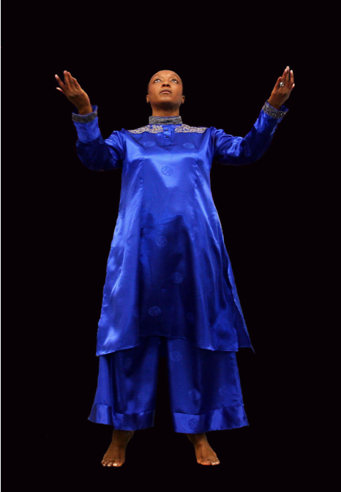
1989, Vilma migrated to the United States and continued pursuing her burning desire to dance.

Slide 4
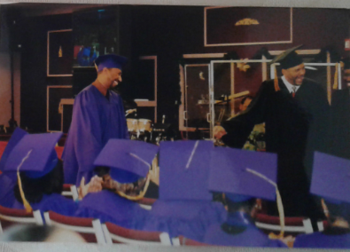
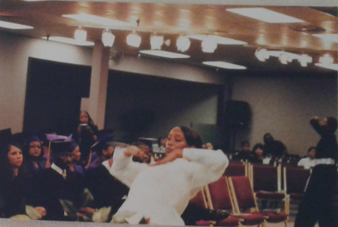
1995-2002, She worshiped and danced at (VCCI) Victory Christian Church International Gaithersburg MD.
Vilma also Completed a two-year course in Ministerial Training and Development and graduated in 2001
After graduation Vilma sat under the teaching of the word for an additional two-years. She also danced at the graduation.

Slide 5
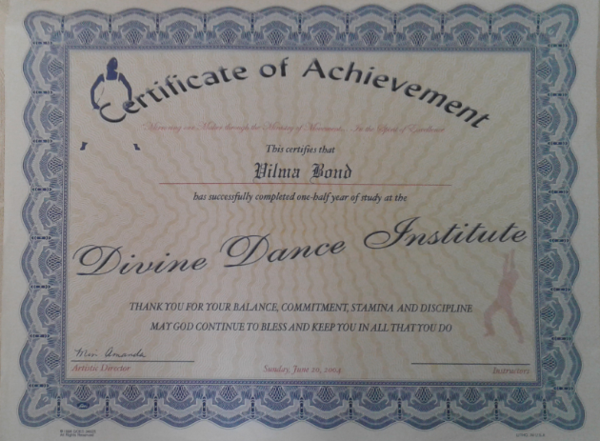
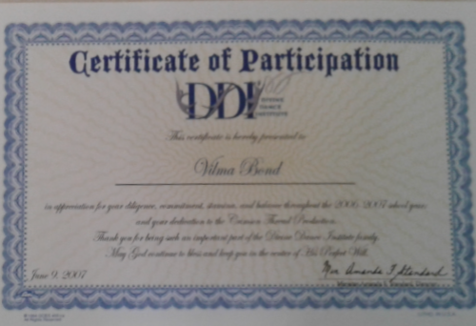
Vilma attended many dance workshops and conferences locally and nationally. She danced with ministries such as:
Dancing under the Anointing Ministries “A. Renee Cooper, Washington DC.
Allen Liturgical Dance Ministry, Jamaica Queens, NY.
Divine Dance Institute Dr. Amanda Standard, Capitol Heights, Maryland.

Slide 6
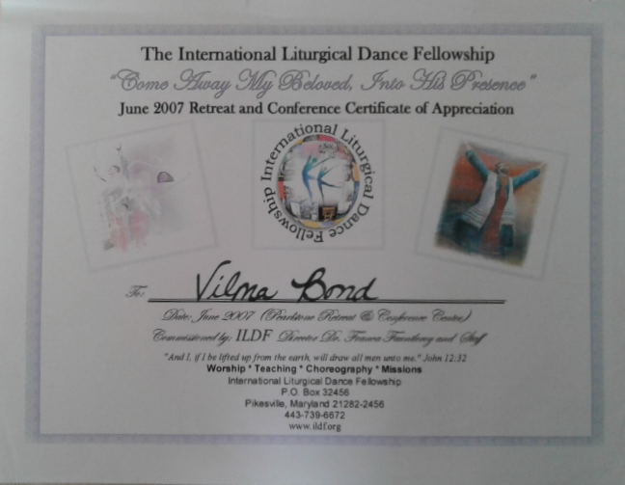
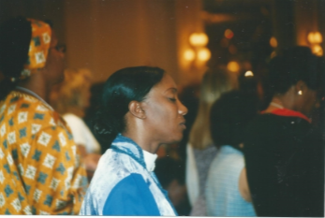
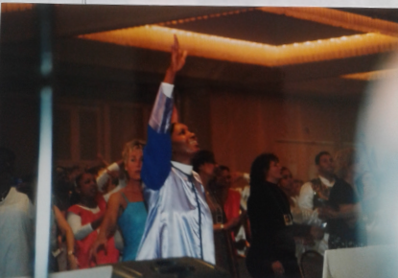
Eagles International Institute. Dr. Pamela Hardy, Plano Texas
Member of National Liturgical Dance Ministry Network, Maryland Chapter.
She held a one-year unlimited membership to the Maryland Youth Ballet (MYB). 2005

Slide 7
May 6, 2000, Vilma conducted her first Dance Workshop for St. Marks United Methodist Church in Laurel, Maryland.

Slide 8
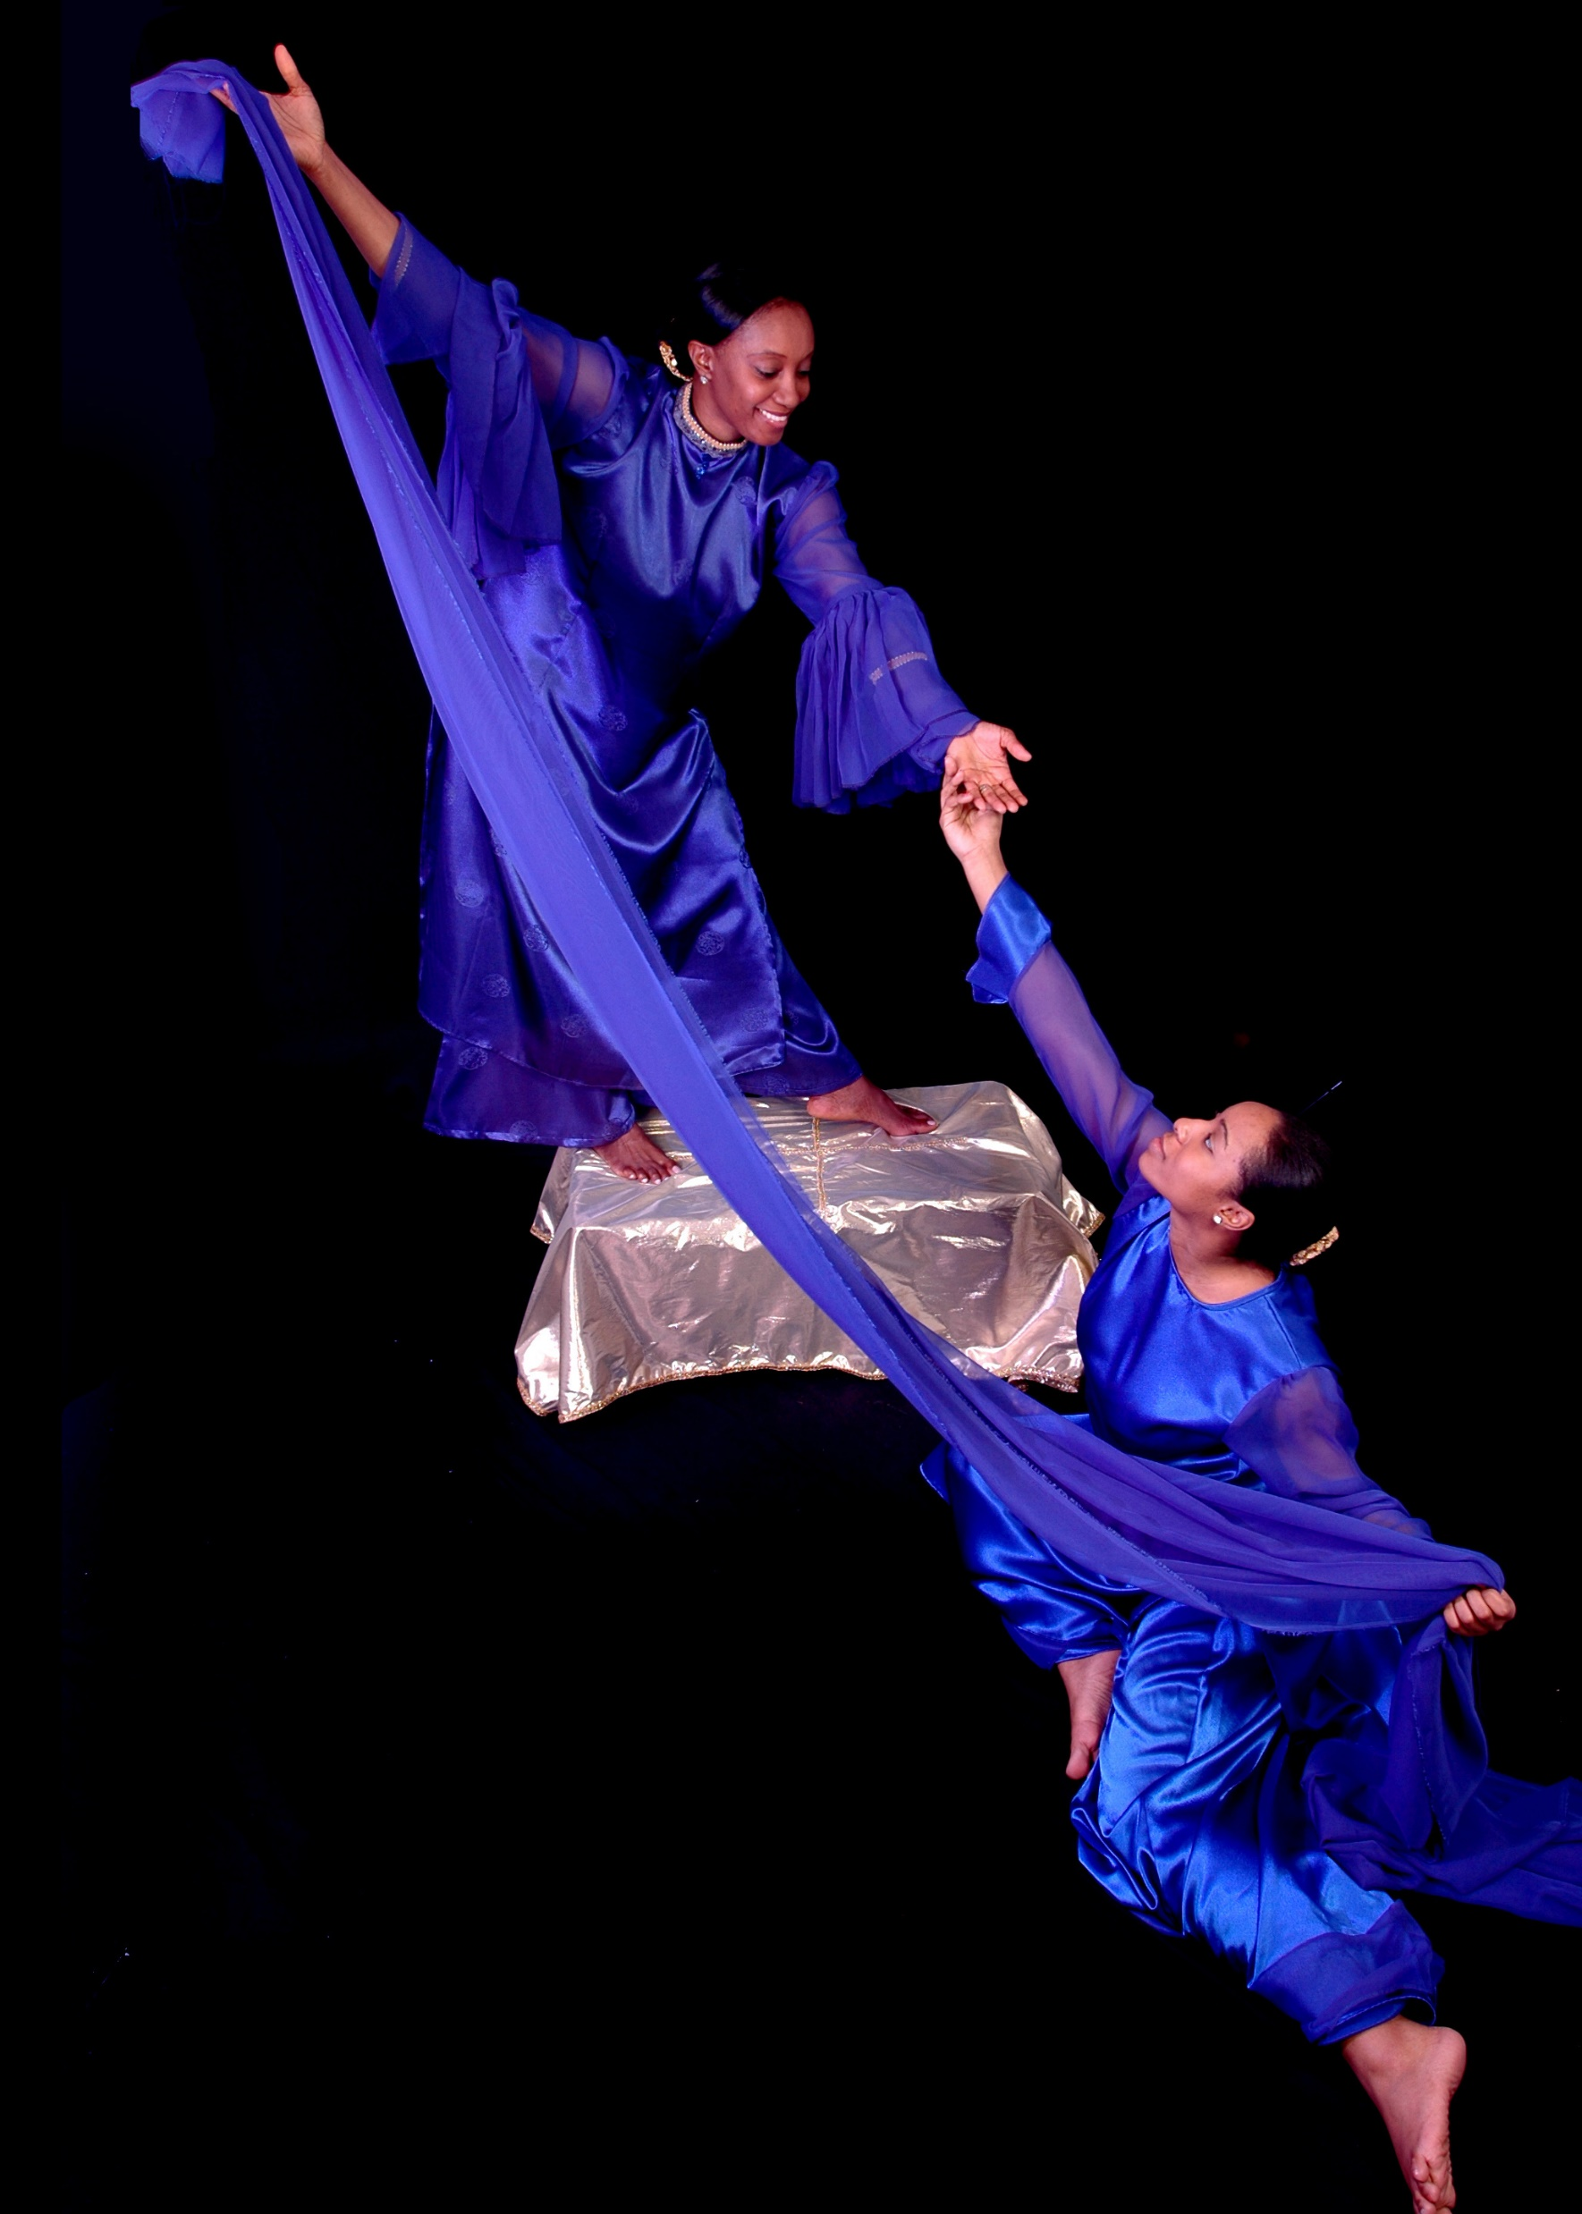
2002-2003 Vilma worship and danced at (VCMI) Victory Christian Ministries International Suitland Maryland.

Slide 9
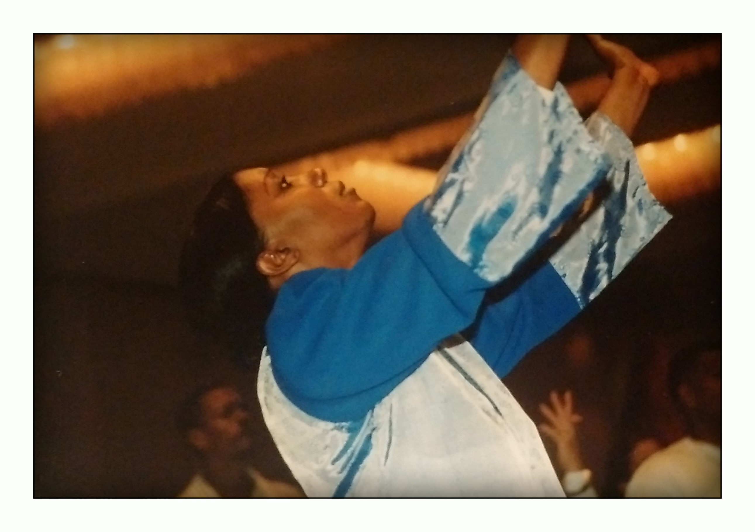
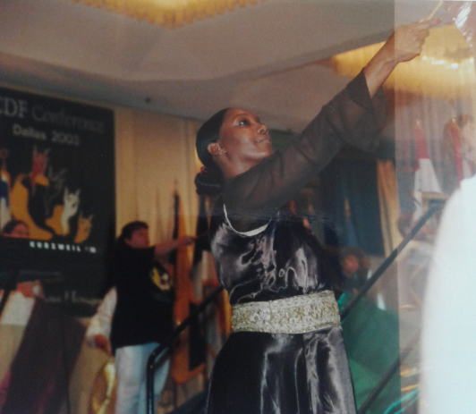
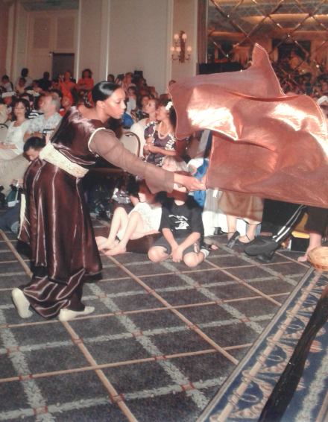
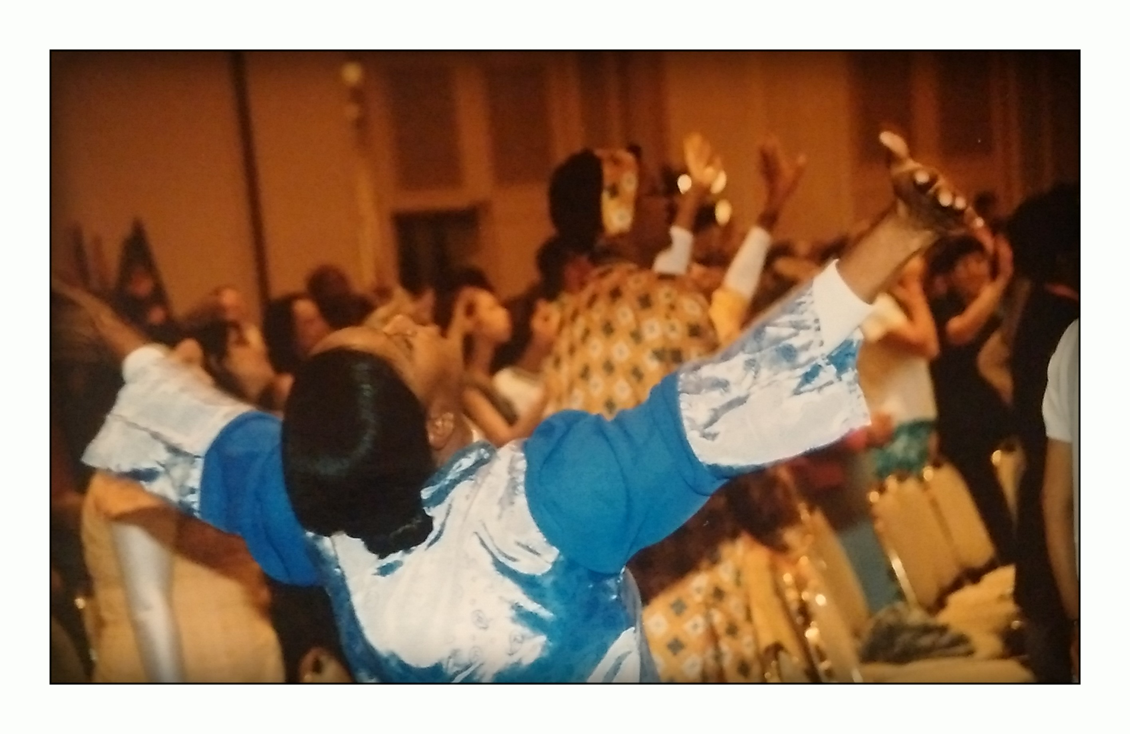
2003, Vilma attended the first International Christian Dance Fellowship Conference, Plano Texas where 29 countries were represented.

Slide 10
2007, Vilma crossed denominational barriers. She was instrumental in assisting to officially start a Dance Ministry at New Hope Adventist Church, Fulton Maryland. Her venture was successful, and She later wrote their First Dance Ministry (By Laws) Manual, and received the copywrite in 2009 .
Manual Front Cover
Manual Back Cover

Slide 11
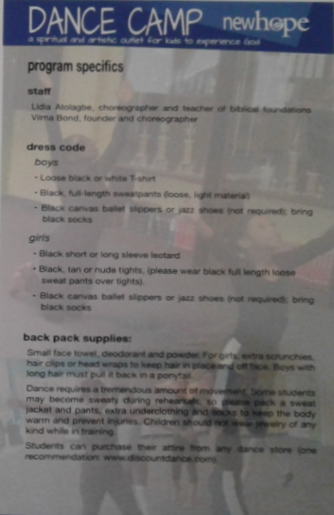
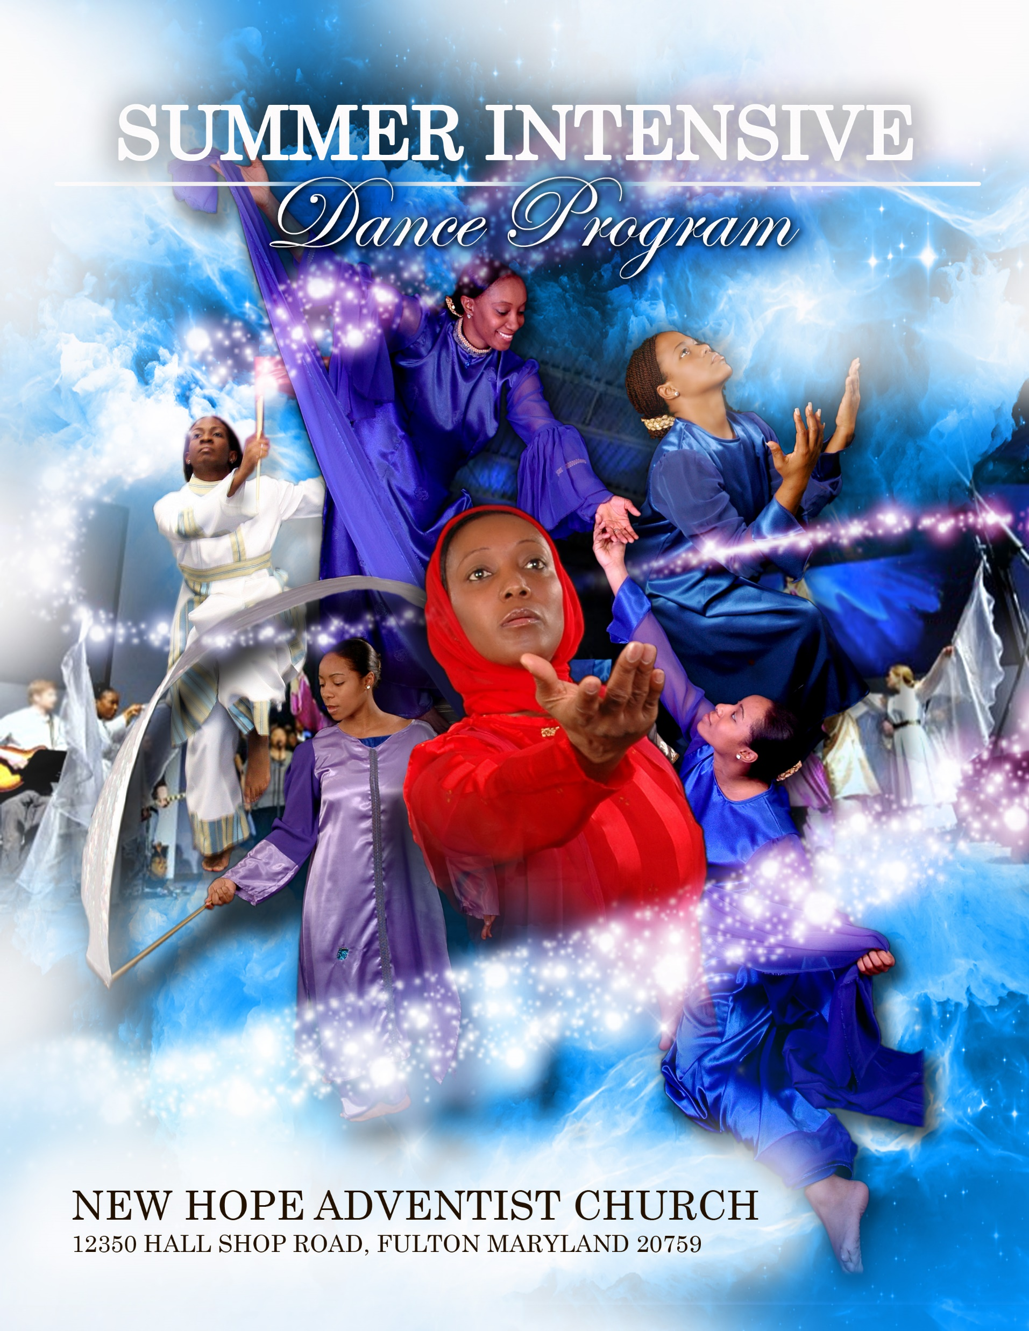
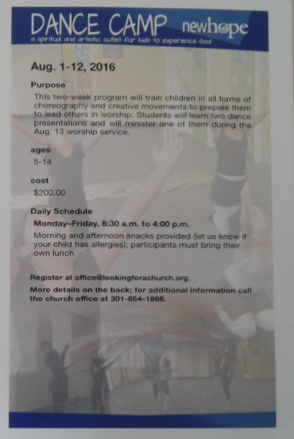
2015, Vilma held the first ever Summer Dance Camp, With New Hope Adventist Church. Flags and Pageantry Instructor: Lay Pastor Lidia Atolagbe Choreographer and movement instructor: Vilma Bond.

Slide 12
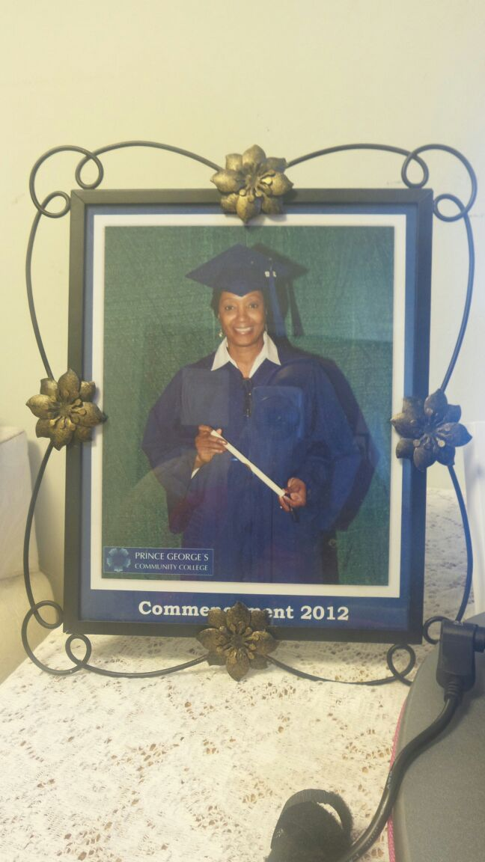
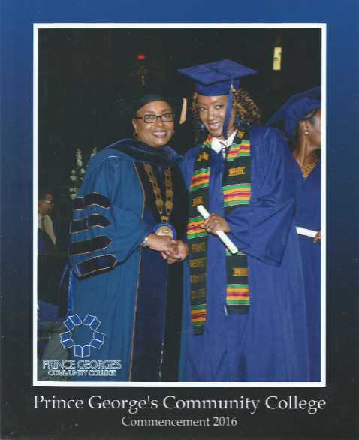
EDUCATION
Education. 2012, Graduate with Certificate in Hospitality and Tourism, Prince Georges Community College, College Park Maryland.
2016 Graduate with an AA in General Studies, Prince Georges Community College, College Park Maryland.

Slide 13
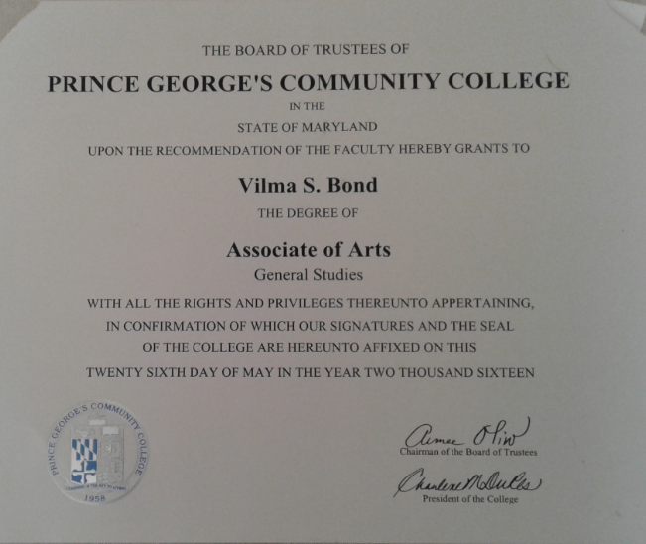
Certificate-Degree

Slide 14
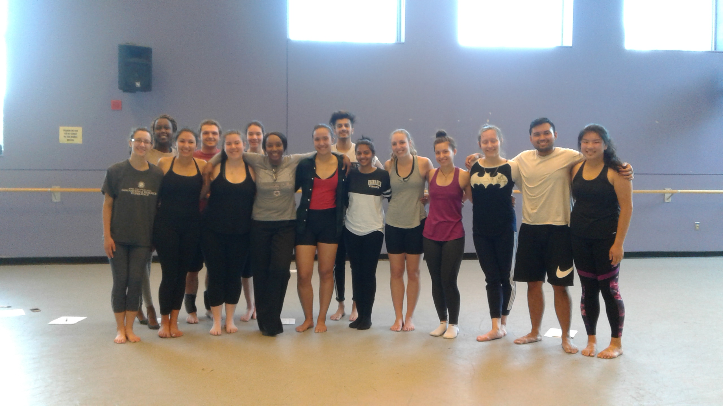
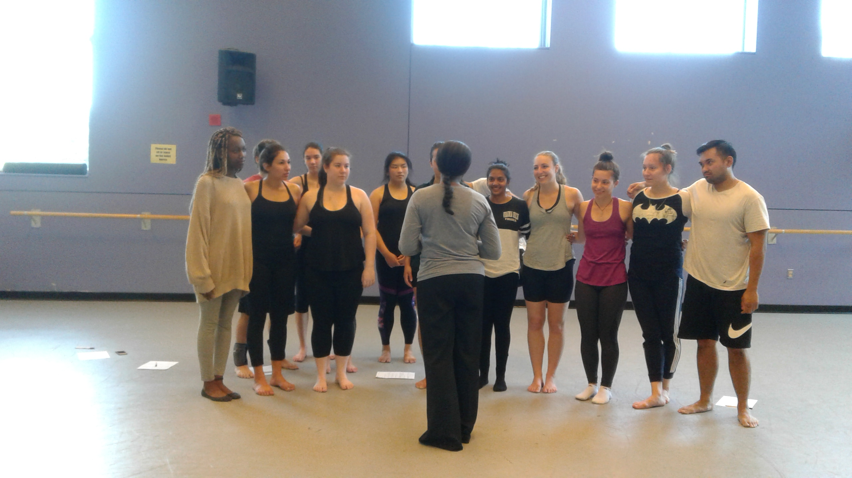
Dance Education
(Letting my class know it was my last day at UMD)
2018 Vilma completed one semester of Dance 218, foundations of technique , Undergraduate studies University of Maryland.
Dance/ Theatre Arts. Graduated class of 2020. AFA Montgomery College Rockville MD.

Slide 15
Pieces that Vilma Choreographed
Lion and the Lamb, music by Crystal Lewis 2003, Video reproduced digitally by Rick Mitchell Videos by design. Featured Dancers, Vilma Bond, and her daughter Petal Mattherson 1998 https://www.purityinmovement.org/video
Woman Thou Art loosed” Music by Vickie Winans. Video reproduced digitally by Rick Mitchell, Videos by design. Featured dancers Vilma Bond, Pastor Candice Villafana, and Petal Mattherson. 1998 https://www.purityinmovement.org
Via Dolorosa, Music by Sandy Patti. Video reproduced digitally by Rick Mitchell videos by design. Featured dancers. Vilma Bond, Petal Mattherson, Musician and flute player Stephanie Pearson. 1998 https://www.purityinmovement.org
Will You Be There. Artist the late Michael Jackson. Soloist/Choreographer Vilma Bond. Accompanying Dancers, Donna Lightsey and 9 others, names unknown. The Arc Theatre Washington DC. 2009 https://www.purityinmovement.org

Slide 16
Continued.
Prophetic Dance: 2014. Soloist Vilma Bond. Artist Big Daddy Weave. “Overwhelmed” Vilma Showed up with the ability to minister in dance on the spot, with no time to choreograph. Department of transportation Washington DC https://www.purityinmovement.org
Social Accomplishments: https://962b763f-e9e6-4e32-9438-1f418171f76d.filesusr.com/ugd/c287a2_45b83df6c2ff48c1b57f547b4709bc02.pdf
Those who are close to Vilma refer to her as a pioneer, multi-talented, with attributes of discipline, patience, Tenacity, excellence, integrity and acceptance of all cultures, able to do exploits. Vilma lives by (Daniel 6:3) and believes that God has given her His Spirit to do all things in Excellence.

