Slide 1
WELCOME VCCI movement ministry LESSON Holy Spirit help in the choreography process

Slide 2
Holy Spirit Help in the choreography process Sessions 1&2

Slide 3
Holy spirit…..
The word Holy Spirit is a noun and is the third person of the trinity. The attributes are Gentleness. Supernatural Deity. Only acts on invitation. Once invited comes like the wind.

Slide 4
CHO-RE-OG-GRA-PHY
Choreia- To Dance
Graphien- To scribe
CHO-RE-OG-GRA-PHY
(A true artform)

Slide 5
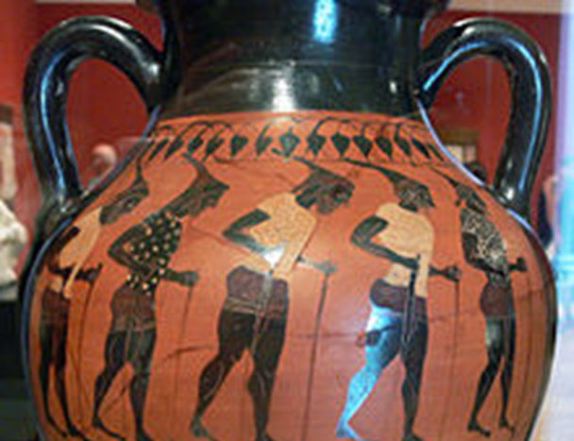
CHO-RE-OG-GRA-PHY “Choreia” An ancient Greek circle dance accompanied by singing

Slide 6
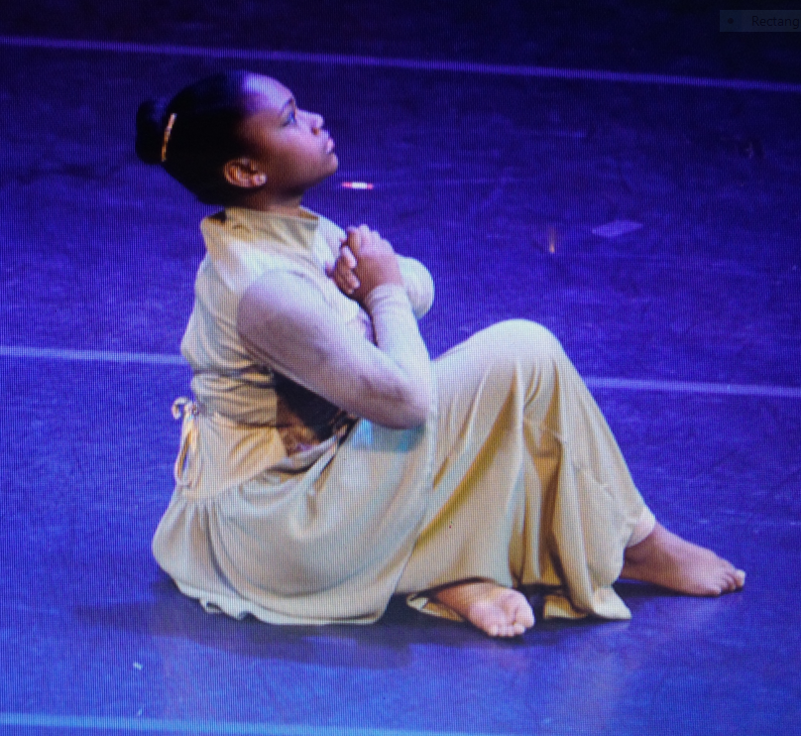
CHOREOGRAPHY is….
a beautiful painting on blank canvas displaying your dance composition

Slide 7
CHO-RE-OG-GRA-PHY
“Choreography is the artform of designing a motif, in other words choreography is the beautiful painting on a blank canvas displaying your dance composition”

Slide 8
RECAP
You learned some amazing attributes of Holy Spirit, and you also learned the ancient Greek words Choreia Graphien, which translates Choreography

Slide 9
Session 1
How do we receive Holy Spirit help in the choreography process without knowing what our limitations are?

Slide 10
Session 1- Limitations
Limitations are any movement we have not, studied, learned, or practiced. Here are 3 examples of limitations,
Able to complete a movement phrase to the right side but have difficulty completing it to the left side
We love the beauty of the pencil turn but we have difficulty executing
Experiencing difficulty completing Chanine turns to the left and right.

Slide 11
Session 1- Limitations
Can we overcome Limitations? Absolutely
Remember that all of us are aspiring choreographers.
The word choreography is a true explicit artform
An artist tools are their paint brushes, canvas, paint, pencils, crayons markers etc.
A musical artist tools are their voice, instruments, pianos, percussions, organs etc.
The movement artist tools are our head, torso, arms, and legs.

Slide 12
The 4 Elements of Dance
Space, how much space do you have and how do you plan to move through that space, example sideways, forwards, backwards, and diagonal, keeping the feet on the floor, laying on the floor leaping high above the floor all define the use of space.
Timing is the tempo and rhythm you choose to use, having the ability to move and be in sync with music or out of sync, you can move ahead of a beat, behind a beat or be in sync with the music.
Shape Your body is the mobile figure or shape, felt by the dancer, seen by others. Shape is the way the body moves and uses space in a three-dimensional way, creating the body shapes as the dancer moves in place or travels through space.
Force or energy would be either light flowing movements or heavy and sharp movements, along with the 4 elements of dance here are tools you must have as you seek holy spirit direction.

Slide 13
Recap
Before we go to session-2 let’s recap. You learned about some amazing attributes of Holy Spirit, you also learned the ancient Greek words Choreia Graphien/ which translates to Choreography, which means the circle dance accompanied by vocals and scribed. Then you learned about your limitations in the choreography process, and steps you can take to overcome.

Slide 14
Session 2
Tools you must have to begin painting your motif, as you seek Holy Spirit direction
You should have the music you are going to use, your music can be vocals, instrumental, or it can be spoken word
You should have an idea of how you are going to enhance your composition, colors you are going to use, lighting, props, digital or 3D graphic backdrops can all be used.
You should have a working knowledge of stage positioning, stage right, stage left, up stage front, down stage rear

Slide 15
Session 2
You should also have a working knowledge of the four elements of dance. Space is the different lines and shape the body makes while moving through space. Timing is the tempo and rhythm you choose to use in your composition, shape Your body is the mobile figure or shape, felt by the dancer, seen by others. Force or energy would be either light flowing movements or heavy and sharp movements
You should also know if your composition is for a group, solo or duet
Now that you have all the tools you need to start painting your composition, you are now ready for your last preparation step.

Slide 16
You are now ready to develop movements into phrases and creating the final structure of your work
In this final step you are now ready to invite Holy Spirit into your personal space, what does that mean and what does that look like?

Slide 17
FINAL PREPERATIONS DECLUTTERING
Relying on the leading of the Holy Spirit for direction in choreography process
Does a Cluttered space equal a cluttered mind?

Slide 18
Does a clear space really mean a clear mind?
It's easy to convince yourself that in order to create, meditate and choreograph your phrases, your sanity must be in check.
Note:
Trusting the process, committing to the process and the end result would be admirable.

Slide 19
CLEAN ZONE ! HOLY SPIRIT ENTERS BY INVITATION
Recap. You learned about some amazing attributes of Holy Spirit, you also learned the ancient Greek word Choreia Graphien/ which translates to choreography, which means “the circle dance accompanied by vocals and scribed”. Then you learned about your limitations in the choreography process and how to overcome them. You also learned that in order to begin the choreography process you must have a working knowledge of the 4 elements of dance, Space, Timing, Shape, Force. Finally, you learned about decluttering the space that you spend time with Holy Spirit, in order to receive inspiration and direction to complete your choreography process.

Slide 20
HOLY SPIRIT PRESENCE IN Your choreography composition

